Slide 1
Model-Based Systems Design with MATLAB/SIMULINK
Slobodan Lubura

Slide 2
What is Model-Based-System Design?
Model-Based-System Design use the models to describe the specifications, operation, performance of a component or a system of components
Instead of listing specification in a text document, a model is used that implements the specifications, operation, and performance of components

Slide 3
What is Model-Based-System Design?
Models can be shared with other engineers:
Engineers do not have to generate their own models from text specifications.
Same model can be used by several engineers at several different levels in the design process.
Component models can be used in larger systems
Models supplied by manufacturers accurately reflect the performance of their components

Slide 4
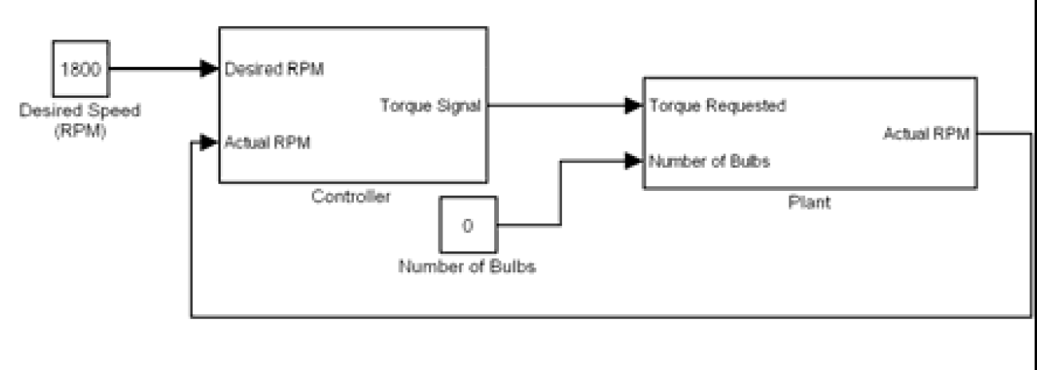
What is Model-Based-System Design?
Model-Based-System Design allows us to uses models throughout the entire design process:
Simulation using Simulink (SIL)
Not real-time
Develop detailed plant model
Develop a controller

Slide 5
What is Model-Based-System Design?
Real-Time Simulations:
Determine how the systems responds in real-time
Good for human-system interaction
Additional debugging
Targeting:
Implement the controller in SIL and make a Real-Time simulations on a hardware target platform (embedded controller)
Most logic errors have been removed
Errors occur if model is inaccurate

Slide 6
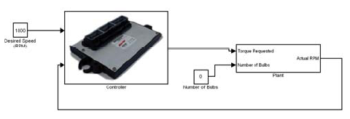
What is Model-Based-System Design?
Hardware in the Loop (HIL) Simulations:
Real-time
Controller implemented on our Target
Plant implemented on a real-time system.

Slide 7
What is Model-Based-System Design?
Hardware in the Loop (HIL) Simulations:
Same physical interface as in actual system
“Smoke-free" testing of the controller
Tests:
Controller logic
Controller speed and processing power
Physical interface.

Slide 8
What is Model-Based-System Design?
Controller deployment:
Given accurate models and a consistent interface, we can just plug in the controller to our plant
It should work perfectly the first time!! (Not)
It should work reasonable well, but we will notice that the plant model may have inaccuracies
Typically we will need to modify the plant and controller to account for the differences.

Slide 9
Example: Model-Based Design of a Motor-Generator System in MATLAB/SIMULINK

Slide 10
Model-Based Design Solution
Create Plant and Controller Models
Motor and Generator Models
P and PI Controllers
Simulate with Simulink
Real-Time Simulations with xPC target
Implement Controller on Microchip dsPIC Real-Time Target or ….
Test
Improve Model and Controller
Repeat

Slide 11
Model-Based Design Solution
Simulation Fallacy!!!!
Simple system models are worthless
We must include:
All component nonlinearities and limitations
Every function the model will perform
The first time we run a simulation of this type the following will occur:
It does not work
It has convergence errors, logic errors, or improper component behavior
It runs but the output is obviously wrong

Slide 12
Modeling Building Philosophy
Start with simple component models
Understand simple component operation
Develop a simple controller
Anticipate expected system output
Verify that output matches expectation

Slide 13
Modeling Building Philosophy
Add a single function to the model and:
Understand the effect on the:
Component
System
Controller
Anticipate the expected system output
Verify that output matches expectation
Repeat as needed…

Slide 14
Model Building with Simulink - High Level System
Using the Simulink to build a model of the plant and controller:
Plant : Motor, Generator, Shaft Encoder
Controller: P or PI
Plant Input : Light bulb load
Controller Input : Generator speed
First build a very simple plant
We are aiming for the following system:

Slide 15
Model Building with Simulink - High Level System
Desired model of plant
Env
Driveline
Shaft input
Encoder output
1
Environment
Actual
Shaft Encoder
RPM
1
Torque request
Motor output
2
Torque
request
Motor
Mechanical output
Number of bulbs
2
Number of bulbs
Generator
Initial Condition

Slide 16
Model Building with Simulink
To build plant (and controller), we will use MBSD:
Start with simple component models
Anticipate the appropriate system responses
Verify the model works correctly
Make ONE improvement
Understand effect on model
Make ONE improvement
Understand effect on model
Repeat

Slide 17
Model Building with Simulink- plant model
The first is created simple a model of ideal DC motor :
Variable torque from 0 to max rated value
No rpm limits
No energy conversion inefficiencies
No frictional losses
Torque is independent of rpm
This is a terribly inaccurate model, but it is an easy to understand first step

Slide 18
Model Building with Simulink- motor model
Use SimDriveline to deploy a simplify motor model
1
0
T
.
167
7
.
6
1
Torque
Motor output
request
Motor torque
Motor
Torque Actuator
constant
current
Inertia

Slide 19
Model Building with Simulink- improved motor model
We will improve the motor model by making the motor torque a function of motor rpm
Use a lookup table to implement the rpm dependence of the motor
Obtain a lookup table from the manufacturer data
Later on we will design an experiment and
measure the actual torque curve of the motor

Slide 20
Model Building with Simulink- improved motor model
Torque vs. RPM dependence of the motor
Motor torque
1
T
Torque
T
B
1
request
2
F
Product
Saturation
Torque Sensor
Motor output
1
Torque Actuator
1
Lookup Table
1
Env
Inertia
1
Driveline
Environment
Encoder output
Shaft input
Shaft Encoder

Slide 21
Model Building with Simulink- Generator Model
Use SimDriveline to deploy a simplify generator model
3000
T
-
1
1
Max RPM
Motor output
Divide
Saturation
1
Torque Actuator
Torque
1
Signal goes from 0 to 1 as speed goes from 0 to 3000 RPM
constant
Env
Inertia
1
Driveline
Environment
60
/(
2
v
*
pi
)
Generator speed (RPM)
rad
/
Motion Sensor
RPM

Slide 22
Model Building with Simulink- Generator Model
Load torque changed linearly with speed

Slide 23
Model Building with Simulink- improved generator model
The max load was equivalent to all of the light bulbs being turned on
The generator produces a voltage that is proportional to the generator speed.
This voltage is applied to the light bulbs, and the bulbs draw current proportional to the voltage applied across them (Ohm’s Law)
To supply the current, the generator produces a torque that opposes its direction of motion.

Slide 24
Model Building with Simulink- improved generator model
Generator current is the generator
voltage divided by resistance of the bulbs in parallel
12
Bulb
resistance
-.
167
T
1
Motor output
Divide
1
1
floor
1
Torque Actuator
Divide
Torque
1
Number of bulbs
Saturation
constant
1
Rounding
Function
Env
Inertia
1
Driveline
Environment
24
v
/
3000
60
/(
2
*
pi
)
rad
Motion Sensor
/
RPM
1
rad
/
Generator voltage is 24V when the RPM is 3000
RPM

Slide 25
Model Building with Simulink- encoder model
The final step is to read the shaft speed through a shaft encoder
We will use the SimDriveline Motion Sensor to convert the SimDriveline signal to a Simulink signal
60
/(
2
*
pi
1
v
)
1
Shaft input
Encoder
Motion Sensor
rad
output
/
RPM
Shaft input
Encoder output
Encoder

Slide 26
Model Building with Simulink- whole plant
Finaly we have a whole model of plant
Env
Driveline
Shaft input
Encoder output
1
Environment
Actual
Shaft Encoder
RPM
1
Torque request
Motor output
2
Torque
request
Motor
Mechanical output
Number of bulbs
2
Number of bulbs
Generator
Initial Condition

Slide 27
Plant model – transfer function
For proper choice a plant controller the transfer function of plant must be known
The first step is bias the plant to operate around the desired operating point
0
.
Torque request
Encoder output
5
Constant
Scope
4
Plant

Slide 28
Plant model – transfer function
With a constant torque input of 0.5 Nm the motor - generator system runs at about 600 rpm
700
RPM
600
500
400
300
200
100
t
0
0
0.5
1
1.5
2
2.5
3

Slide 29
Plant model – transfer function
Now that we have our plant biased at 600 rpm, we will introduce a small-signal sine wave at the input and measure the magnitude of the output at various frequencies
0
Torque request
Encoder output
.
5
Constant
1
Scope
4
Plant
Sine Wave

Slide 30
Plant model – transfer function
As results we see the following output waveform:
660
640
Small signal sine
wave around
operating RPM
620
600
580
560
540
520
500
50
100
150
200

Slide 31
Plant model – transfer function
As results we have the Bode’s plot of transfer function:
Motor Generator Magnitude Response
65
60
55
50
Amplitude (dB)
45
40
35
30
25
-1
0
1
2
3
4
10
10
10
10
10
10
Frequency (rad/sec)

Slide 32
Model Building with Simulink-controller
We will start with simple P controler
Now we have a top-level block diagram
1
Desired RPM
P-Gain
1
Out
2
Saturation
1
Actual RPM
Error amplifier
1800
Desired RPM
Constant
Out
1
In
1
Actual RPM
Actual RPM
Controller
Plant

Slide 33
Model Building with Simulink- Plant response for different controller Gain

Slide 34
Model Based System design
This is why we do MBSD
Understand a complex system using simple components
Understand effect of controller and components / loads on system response
Identify model shortcomings for future improvement

Slide 35
Model Building with Simulink - Improved Model - Friction
The easiest way to add friction is to incorporate a Friction Clutch into the plant
Env
Driveline
Environment
2000
Desired RPM
Torque req
Motor output
Desired RPM
Out1
Shaft input
Encoder out
1
Actual RPM
Actual
Controller
Motor
Shaft Encoder
RPM
0
pressure
Number
Number of bulbs
of bulbs
Max RPM
1
Motor output
P
Generator
B
F
Housing
Controllable
Friction Clutch
Initial Condition
Added friction

Slide 36
Model Building with Simulink - Improved Model - Friction
The frictionless system hasn’t steady state error !!!!
2200
2000
1800
1600
1400
RPM
1200
1000
800
600
400
200
0
0.5
0.45
0.4
0.35
0.3
Nm
0.25
0.2
0.15
0.1
0.05
0
0
0.05
0.1
0.15
0.2
0.25
0.3

Slide 37
Model Building with Simulink - Improved Model - Friction
If we introduce some friction in system then we have steady state error !!!!
2200
2000
1800
1600
1400
RPM
1200
1000
800
600
400
200
0
0.5
0.45
0.4
0.35
Nm
0.3
0.25
0.2
0.15
0.1
0.05
0
0.05
0.1
0.15
0.2
0.25
0.3

Slide 38
Plant Model – Coast Down test
In vehicle design, a data point for verifying the accuracy of the mechanical model of the vehicle is a coast-down test
Set the engine and motors to zero torque and set the vehicle initial speed and put it to coasts down to zero speed
Tests and measures aerodynamic drag and vehicle frictional losses

Slide 39
Plant Model – Coast Down test
Our goal is found the pressure value of the friction clutch to match the measured coast-down time to the simulated coast-down time
Instead of searching for the clutch pressure manually, we will use the Simulink Response Optimization toolbox
Suppose that we already have a set points from the measured rpm trace

Slide 40
Plant Model – Coast Down test
Motor-Generator Coast Down characteristics
3000
2500
2000
RPM
1500
1000
500
0
0
0.05
0.1
0.15
0.2
0.25
0.3
0.35
0.4
0.45
0.5
t

Slide 41
Plant Model – Coast Down test
Inside the plant, we need to set the initial condition of speed
We will add a new torque source that balances the torque due to friction
While the forces are balanced, the motor – generator system will maintain the initial rpm, whatever it is
When we want the system to coast-down we set the added torque source to zero

Slide 42
Plant Model – Coast Down test
Env
Driveline
Environment
Desired RPM
Out
1
Torque request
Motor output
2
Shaft input
Encoder output
1
Actual RPM
Actual
Controller
Motor
Shaft Encoder
RPM
0
pressure
Number
Number of bulbs
Signal Constraint
of bulbs
Max RPM
1
Motor output
1
P
Generator
1
B
F
Optimization
toolbox
Housing
Controllable
Friction Clutch
Initial Condition
1
T
Added compensation torque
Step
Product
Torque Actuator
1

Slide 43
Plant Model – Coast Down test
Simulated Coast Down function for pressure=0.05
3500
3000
2500
2000
1500
1000
500
0
0
0.05
0.1
0.15
0.2
0.25
0.3
0.35
0.4

Slide 44
Plant Model – Coast Down test
We will now use the MathWorks Simulink Response Optimization toolbox to determine the optimum value of the Pressure so that the response of our model matches the measured response
Finally we have results for optimal value of pressure, pressure=1.1989

Slide 45
Plant Model – Coast Down test
We will now use the MathWorks Simulink Response Optimization toolbox to determine the optimum value of the pressure so that the response of our model matches the measured response
Finally we have results for optimal value of pressure, pressure=1.1989

Slide 46
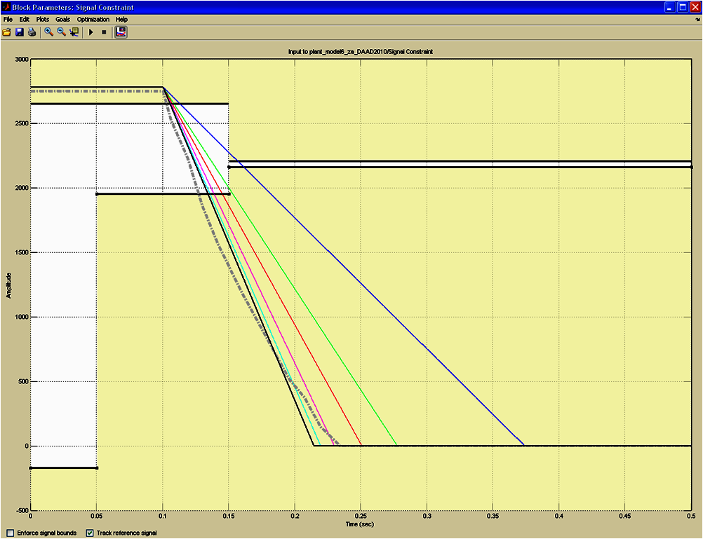
Plant Model – Coast Down test

Slide 47
Model Building with Simulink – Friction Model Notes
The proposed friction model has a linear change from high rpm to zero. The actual response looks like an exponential decay – somewhat
Our model of a constant frictional torque is probably too simple
Friction is probably a function of rotational speed and have nonlinear characteristics???

Slide 48
Model Building with Simulink – Signal Filtering and scaling for dsPIC ECU
We now need to clean up our model in terms of the signals being sent to the controller
Tacho signal (0-10 V) is passed through a combination resistive divider and low pass filter to:
Eliminate noise on the signal
Change range to 0-5 V

Slide 49
Model Building with Simulink – Signal Filtering and scaling for dsPIC ECU
From circuit analysis we have:
This is Eq. of low-pass filter

Slide 50
Model Building with Simulink – Signal Filtering
Implementation low pass filter in SIMULINK:
10000
1
/
5
1
10
s
+
20000
Out
2
Step
1
Saturation
1
Low pass filter
Scaling gain

Slide 51
Model Building with Simulink Improved Signals - Controller
Next step is including low pass filter in P controller:
1
1
/
3000
Desired RPM
50
1
Error amplifier
3
Saturation
Out
1
P gain
10000
2
1
/
300
1
/
5
Actual RPM
10
s
+
20000
Error amplifier
2
Error amplifier
1
Saturation
1
Transfer Fcn

Slide 52
Model Building with Simulink Improved Controller - PI
PI Control:
One of our goals is to design a controller for our system
Now that we have a good plant model, we can use all of our knowledge of control systems to design controllers.
We will improve existing controller adding an integrator to our system because:
A proportional gain controller yields an error that is inversely proportional to the gain
Too high of a proportional gain can make the system oscillate

Slide 53
Model Building with Simulink Improved Controller - PI
Implemented PI Controller
1
1
/
3000
Desired RPM
200
1
Error amplifier
3
Out
Saturation
1
P
_
gain
2
In
1
Out
1
Actual RPM
K Ts
1
1000
z
-
Tacho signal
1
conditioning
I
_
gain
Discrete
-
Time
Integrator

Slide 54
Model Building with Simulink Improved Controller - PI
System response for P controller no load bulbs
2200
2150
2100
2050
RPM
2000
1950
1900
1850
1800
2
1.8
1.6
1.4
1.2
Nm
1
0.8
0.6
0.4
0.2
0
0
0.1
0.2
0.3
0.4
0.5
0.6
0.7
0.8
0.9
1

Slide 55
Model Building with Simulink Improved Controller - PI
System response for P controller max load bulbs
2200
2150
2100
2050
RPM
2000
1950
1900
1850
1800
2.6
2.4
2.2
2
Nm
1.8
1.6
1.4
1.2
1
0.8
0
0.5
1
1.5
2
2.5
3
3.5
4

Slide 56
Model Building with Simulink Improved Controller - PI
System response for PI contoller no load bulbs
2200
2150
2100
2050
RPM
2000
1950
1900
1850
1800
2
1.8
1.6
1.4
1.2
Nm
1
0.8
0.6
0.4
0.2
0
0
0.5
1
1.5
2
2.5
3

Slide 57
Model Building with Simulink Improved Controller - PI
System response for PI controller max load bulbs
2200
2150
2100
2050
RPM
2000
1950
1900
1850
1800
2.6
2.4
2.2
2
Nm
1.8
1.6
1.4
1.2
1
0.8
0
0.5
1
1.5
2
2.5
3

Slide 58
Model Building with Simulink conclusion
MBSD is a powerful technique for complex system design
MBSD can include a lot of different types of models in whole design
MBSD is common part of rapid prototyping process with no waste of time.
We can “Smoke-free" testing all the plant parts

Slide 59
Thank you for attention

